Slide 1
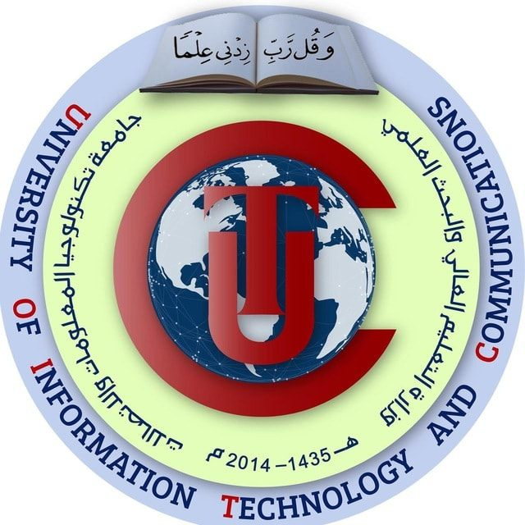
THE EMERGENCE AND DEVELOPMENT OF ADMINISTATION IN THE POST-CHRISTION’S PERIOD
In roman and Islamic civilization and the period of contemporary history
Presented To: Dr. Shaimaa Riyad Khalifa
Presented By: Ali khalid jabaar, hameed emad hameed and Um Al-Banein yaaqub yusuf

Slide 2
Introduction
Studying the history of management holds significant importance in understanding how managerial practices have evolved over time and the impact they have had on the development of societies. Here is a general overview of the importance and influence of studying the history of management:
Understanding Historical Evolution
The study of the history of management allows for an understanding of how management practices have changed from simple approaches in ancient times to the complex systems of the modern era. This enables the comparison of evolution and helps comprehend what works and what does not in the context of management.
Identifying Best Practices
Management history can provide lessons on best practices developed over time. Understanding these practices helps current leaders and managers improve their performance and make more effective decisions.
Impact of Culture and Technology
The history of management showcases how managerial practices were influenced by changes in culture and technology throughout the ages. This helps in understanding how economic and social developments can impact managerial approaches.
Analyzing Mistakes and Successes
Through studying historical management cases, learners can gain insights from both mistakes and successes. This enables them to avoid repetitive errors and adopt successful strategies.
Appreciating the Role of Leaders
Management history emphasizes the crucial role of leaders in guiding societies and organizations toward development and improvement. It illustrates how influential figures were affected by specific challenges and circumstances, and how they achieved progress.
Application of Existing Concepts
The study of management history can serve as a foundation for applying existing concepts in the field of modern management. It enhances the understanding of managers and leaders regarding current challenges and how to navigate them.

Slide 3

Roman civilization
The Roman Republic:
In the early period, administration in Rome was centered around the institutions of the Republic. Various governmental structures, including the Senate (Senates) and the Tribunes of the Plebs (Tribune Plebes), played roles in policy formulation and decision-making.
Local Administration:
Local administration systems evolved in Roman cities to accommodate the vastness of the empire. Governors and local officials were appointed to manage local affairs, with specified powers to ensure stability in regional communities.
Military and Civil Responsibilities:
In the face of external threats and imperial expansion, administration became integrated with military jurisdiction. Roman generals, who sometimes became princes, took on additional administrative duties to maintain order in the occupied territories.
Empire Development:
As the Roman Empire rose, administration witnessed significant transformations. Emperors established central administrative structures to organize imperial affairs, with advisors and local governments tasked with policy implementation.

Slide 4
The governance and administration systems of ancient Rome were complex and evolved over time. Here is an overview of some of the roman governance and administration systems:
Roman Republic:
Independent judicial structures existed in Rome, consisting of courts and judges responsible for resolving conflicts and enforcing laws.
Local Councils:
Empire Governance:
Judiciary:
Roman cities had local government structures overseeing daily life.
These local councils included municipal authorities and officials responsible for
organizing infrastructure and public services.
Roman cities had local government structures overseeing daily life. These local councils included municipal authorities and officials responsible for organizing infrastructure and public services.
Military Integration into Administration:
In the early period, Rome operated as a republic with governmental institutions such as the Senate (Senates) and the Tribunes of the Plebs (Tribune Plebes). Both the Senate and the Plebeian Assembly played roles in decision-making and policy formulation.
Military and civil administration became integrated in Rome. Generals, who sometimes became rulers, took on additional administrative responsibilities in the regions they governed, leading to a fusion of military and civilian aspects of administration.

Slide 5
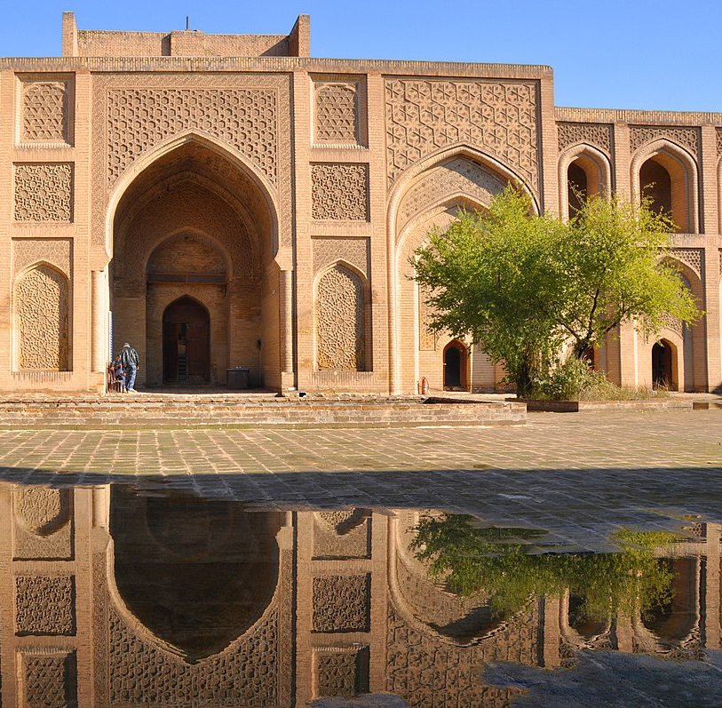
Islamic civilization
The Rightly Guided Caliphs
After the death of Prophet Muhammad (peace be upon him), the era of the Rightly Guided Caliphs began. This period was characterized by a focus on social justice and the implementation of Shura (consultation) in governmental decision-making.
Emergence of Emirates and Dynasties
Over time, numerous emirates and dynasties emerged within the Islamic world, leading to diverse administrative systems. Local governance became prominent, with many of these entities enjoying a significant degree of autonomy.
Military Administration
Military administration played a crucial role during this period, with shared governance between military and civilian authorities. Effective systems were established to manage armies and organize defense strategies.
Judicial System
A judicial system based on Islamic law (Sharia) was developed during the Islamic era. Courts were responsible for handling cases, applying laws, and implementing punishments in accordance with Islamic legal principles.
Tolerance and Cultural Pluralism
The Islamic period was known for its tolerance and cultural pluralism. There was a respect for diverse communities, encouraging civic participation and benefiting from cultural diversity.
Advancements in Sciences and Arts
Significant progress was made in the fields of sciences and arts during the Islamic era. Support for education and culture was evident, and scholars and artists played a substantial role in shaping and advancing administration.

Slide 6
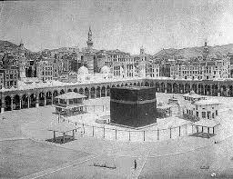
In the era of the Prophet Muhammad (peace be upon him), administration was conducted in accordance with Islamic principles and the Prophet's Sunnah (traditions). Prophet Muhammad was not only a religious leader but also a political ruler and military commander
Spiritual and Political Leadership
Prophet Muhammad served as both a religious and political leader, assuming leadership in Medina after the Hijra (migration). He guided the people in both religious and worldly matters, teaching them through divine revelation and the Prophet's traditions.
Justice and Fair Distribution
Justice and fair distribution were prominent features of administration in the time of the Prophet. He addressed issues justly and ensured equitable distribution of resources among the Muslim community.
Consultation and Shura
The principle of consultation (Shura) was a fundamental aspect of decision-making. The Prophet regularly sought the advice of his companions, holding consultations before making major decisions.
Military Administration
Facing military challenges, the Prophet played a significant role in organizing the Islamic army. He strategically planned battles and effectively directed military forces.
Community Organization
The Prophet organized the community effectively by establishing laws and regulations to govern daily life and social interactions.
Promotion of Learning and Education
The Prophet emphasized the importance of learning and education. He encouraged the pursuit of knowledge and education in Islam, promoting the teaching of the Quran and various sciences.

Slide 7
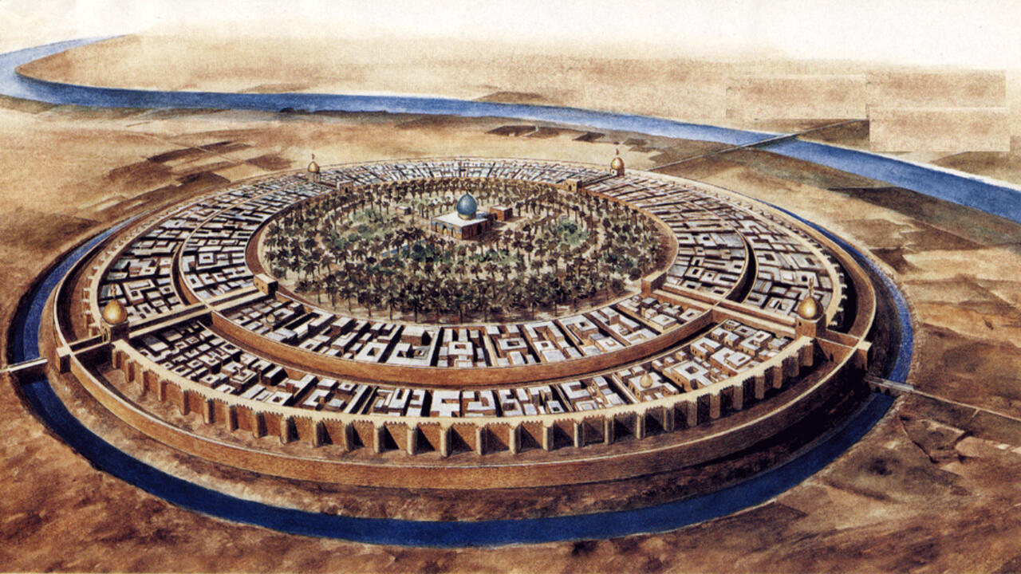
The concept of Caliphate in Islam represents the governing system based on religious leadership and spiritual authority for Muslims. The Caliphate existed since the early days of Islam during the reign of the four Rightly Guided Caliphs, who succeeded Prophet Muhammad (peace be upon him). It continued to evolve over the Islamic centuries.
The Rightly Guided Caliphs
The Islamic Caliphate began with the Rightly Guided Caliphs: Abu Bakr, Umar ibn al-Khattab, Uthman ibn Affan, and Ali ibn Abi Talib. They were considered the successors to the Prophet and served as both spiritual and political leaders.
Umayyad and Abbasid Caliphates
Following the era of the Rightly Guided Caliphs, the Umayyad and Abbasid Caliphates were established. These periods witnessed economic and cultural growth, with the development of advanced administrative structures, including provinces and governorates.
Emirates and Sultanates
In some regions, Emirates and Sultanates emerged as local forms of governance. These entities had independent local administrative structures overseeing local affairs, often enjoying a degree of autonomy.
The Ottoman Empire
After the fall of the Abbasid Caliphate, the Ottoman Empire rose to prominence. It featured a centralized administrative system with emirates and provinces governed by diverse councils, emphasizing justice and stability.
Sharia law played a significant role in the administrative system of Islamic countries. Sharia courts were responsible for resolving disputes and implementing legal judgments based on Islamic legal principles.
Cultural Coexistence
Cultural and religious coexistence was a hallmark of the Islamic administrative system. Governments respected the diversity of communities, encouraging civic participation and benefiting from cultural pluralism.
Sharia Law

Slide 8
The administration in Islam has been significantly influenced by the concepts of justice and shura, as these principles are integral parts of Islamic teachings and the Prophet's traditions.
Justice
The concept of justice is at the core of Islamic administration. It is encouraged for rulers and administrators to be just in all their decisions and actions. Islam emphasizes the fair treatment of people without bias, and the equitable distribution of resources and opportunities is expected.
Shura (Consultation)
The concept of shura, or consultation, involves seeking advice and input from others in decision-making. Islam underscores the importance of shura in administration, and Prophet Muhammad effectively implemented it. This concept encourages dialogue and the consideration of diverse viewpoints to ensure better and more inclusive decision-making.
Communication and Participation
These concepts encourage effective communication and participation between the government and citizens. Muslims are encouraged to participate in public affairs, promoting interaction between the government and society to ensure justice and meet the needs of the people.
Effective Governance
Justice and shura are considered key elements for achieving effective governance. Listening to public opinion and working with the spirit of shura enhances transparency and strengthens trust between the government and the community.
Social Justice
The concepts promote the achievement of social justice in public administration. Directing attention to vulnerable groups and ensuring the fair distribution of wealth reflects Islam's focus on achieving balance and justice in society.

Slide 9
Contemporary historical period
The emergence and evolution of management in the modern and contemporary eras have been shaped by significant economic, social, and technological changes. Here is an analysis of the development of management during these periods:
Modern Era
Industrial Revolution: In the 18th century, the Industrial Revolution brought about profound changes in the economy and production. The transition from traditional industries to mechanized industries led to the emergence of new managerial practices to oversee industrial processes and labor.
Scientific Management: In the late 19th and early 20th centuries, scientific management, pioneered by figures like Frederick Taylor in the United States, emerged. This approach focused on improving efficiency and productivity through the scientific study of production processes.
Bureaucratic School of Management: The bureaucratic school of management, influenced by thinkers like Max Weber, emerged in the 19th and early 20th centuries. It emphasized hierarchical organization and centralized management to achieve efficiency and effectiveness in organizations.

Slide 10
Contemporary historical period
2. Contemporary Era
Globalization and Information Technology: In the contemporary era, management has been influenced by globalization and the rapid advancement of information technology. Management techniques have adapted to the fast-paced changes in global markets and communication structures.
Strategic Management: Concepts of strategic management have become prominent, focusing on setting long-term goals and formulating strategies to achieve them. Strategic planning has integrated with overall management practices to ensure coherence between objectives and execution.
Flexibility and Change Management: In the face of rapid changes, effective change management and fostering organizational flexibility have become crucial. Adaptability to evolving challenges is a key aspect of contemporary management practices.
Diversity and Human Resource Management: There is an increased focus on diversity and inclusion in contemporary management. Understanding diverse demographics and effective interaction with human resources have become vital components of modern management.

Slide 11
The role of technology and globalization has played a crucial part in shaping modern management practices. Here's an analysis of how these factors have influenced contemporary management methods:
1. Technology:
Enhanced Communication: Modern management benefits from advanced communication technologies such as email and social media, fostering improved internal and external communication. This facilitates quicker decision-making and enhances team collaboration.
Data Analysis and Artificial Intelligence: Utilizing data analysis tools and artificial intelligence contributes to data-driven decision-making. These technologies aid in performance analysis, process improvement, and strategic decision-making based on accurate data insights.
Improved Efficiency and Productivity: Technology is harnessed to enhance production processes and resource management, leading to increased efficiency and productivity. Automation and information technology help reduce errors and expedite managerial processes.
2. Globalization:
Expanded Market Reach: Globalization has expanded international market opportunities. Modern management must be prepared to oversee operations on a global scale, necessitating updates to management approaches to accommodate the challenges of international business.
International Collaboration: Globalization enables collaboration between international entities. Modern management focuses on building international teams and improving cross-cultural understanding to enhance global collaboration.
Multicultural Challenges: With increased interaction between diverse cultures, modern management requires a deep understanding of cultural challenges and the integration of strategies that embrace diversity.
Sustainability and Corporate Social Responsibility: Modern management must align with global concerns for sustainability and corporate social responsibility. This integration involves adapting business management concepts to address environmental and social challenges.

Slide 12
Cultural and religious influences
Cultural Influence:
Community Values: Cultural values play a crucial role in shaping how management is organized. In some cultures, collective values are highly prioritized, promoting teamwork and collaborative decision-making within management practices.
Communication Styles: Different cultures have varying communication styles. A nuanced understanding of customary communication practices in a specific culture can enhance the effectiveness of management and interactions between culturally diverse teams.
Managing Diversity: Interaction with cultural diversity poses both a challenge and an opportunity. Developing management methods that encourage diversity and respect for different cultural backgrounds can lead to more diverse and effective teams.
2. Religious Influence:
Religious Values: Management in certain cultures may align with religious values and ethics. These values can impact decision-making and guide leadership behaviors within organizations.
Social Responsibility: Religion can be a source of commitment to social responsibility. Management, influenced by religious values, may demonstrate heightened sensitivity to social and environmental impacts in decision-making.
Work Ethics: Religion often emphasizes work ethics, influencing the development of management styles that promote ethical interactions and justice within the organization.

Slide 13
Conclusion
In this presentation, several important topics and details in management, its history and its origins were discussed. Here are the most prominent things that have been written.
History of Management
The significance of studying the history of management to understand the evolution of managerial practices and their impact on societies.
Roman Civilization
The emergence of management in the Roman civilization before Christ.
Overview of Roman governance and administration systems.
Islamic Civilization
The development of management in the Islamic civilization after Christ.
Discussion on the caliphate and administrative systems in Islamic countries.
Impact of Cultural and Religious Concepts on Management
How cultural and religious elements influenced the development of management methods in modern and contemporary eras.
Impact of Globalization and Technology
The role of technology and globalization in shaping modern management methods.
Management, Justice, and Shura in Islam
How management was influenced by concepts of justice and Shura in Islam.
Development of Management Methods Due to Culture and Religion
How cultural and religious elements impact the development of management methods and systems in general.

Slide 14
Sources
For the Roman Civilization:
Harris, W. V. (2012). "Rome's Imperial Economy: Twelve Essays." Oxford University Press.
Beard, M., & Crawford, M. (Eds.). (1999). "Rome in the Late Republic." Cornell University Press.
Jones, A. H. M. (1974). "The Later Roman Empire, 284-602: A Social, Economic, and Administrative Survey." JHU Press.
For the Islamic Civilization:
Watt, W. M. (1953). "Free Will and Predestination in Early Islam." Luzac & Company.
Ghazanfar, S. M. (1995). "Medieval Islamic Economic Thought: Filling the 'Great Gap' in European Economics." Routledge.
Ibrahim, A. B. (1999). "The Foundations of Islamic Political Economy." Palgrave Macmillan.
For the Contemporary Period:
Chandler, A. D. (1977). "The Visible Hand: The Managerial Revolution in American Business." Belknap Press.
Drucker, P. F. (1974). "Management: Tasks, Responsibilities, Practices." HarperCollins.
Mintzberg, H. (1973). "The Nature of Managerial Work." Harper & Row.
Online Resources:
Harvard Business Review - Various articles on historical and contemporary management practices.
Journal of Management History - Academic journal covering the history of management thought.
Google Scholar - Search for specific articles or academic papers on the history of management.

Slide 15

THANKS

